Slide 1
Compartment model to analyze testing strategies and hospitalization capacity scale-up
Vijeta Deshpande
March 28, 2020

Slide 2












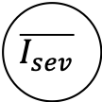










Schematic
$$r_{0}$$
$$μ_{d}$$
$$μ_{d}$$
$$R$$
$$R$$
$$r$$
$$asym$$
$$γ$$
$$sym$$
$$r$$
$$d_{E}$$
$$d_{I}$$
$$μ_{d}$$
$$diagnose$$
$$r$$
$$\overline{μ_{mild}}$$
$$τ_{mild}$$
$$\overline{r_{mild}}$$
$$\overline{I_{mild}}$$
$$τ_{sev}$$
$$\overline{μ_{sev}}$$
$$\overline{I_{sev}}$$
$$\overline{r_{sev}}$$
Death

Slide 3
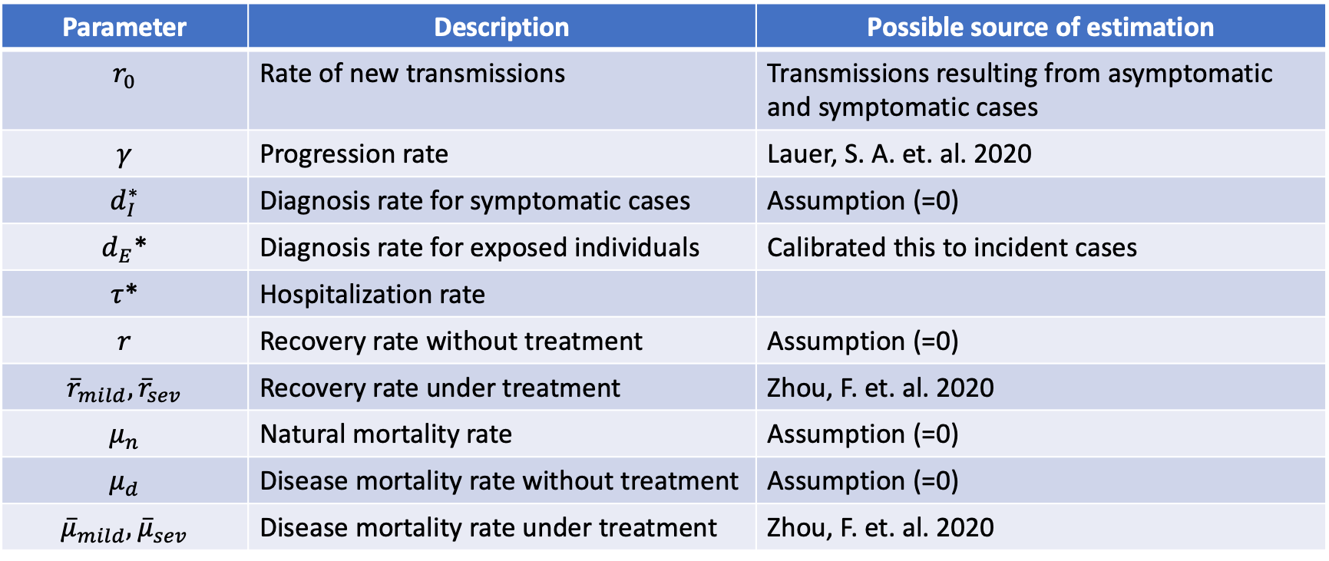
Parameters
Parameter | Description | Possible source of estimation
$$r_{0}$$ | Rate of new transmissions | Transmissions resulting from asymptomatic and symptomatic cases
$$γ$$ | Progression rate | Lauer, S. A. et. al. 2020
$$d_{I}^{∗}$$ | Diagnosis rate for symptomatic cases | Assumption (=0)
$d_{E}$* | Diagnosis rate for exposed individuals | Calibrated this to incident cases
$τ$* | Hospitalization rate
$$r$$ | Recovery rate without treatment | Assumption (=0)
$${\overline{r}}_{mild},{\overline{r}}_{sev}$$ | Recovery rate under treatment | Zhou, F. et. al. 2020
$$μ_{n}$$ | Natural mortality rate | Assumption (=0)
$$μ_{d}$$ | Disease mortality rate without treatment | Assumption (=0)
$${\overline{μ}}_{mild},{\overline{μ}}_{sev}$$ | Disease mortality rate under treatment | Zhou, F. et. al. 2020
*: Probable analysis goals

Slide 4
Calibration model for testing/diagnosis rate

Slide 5
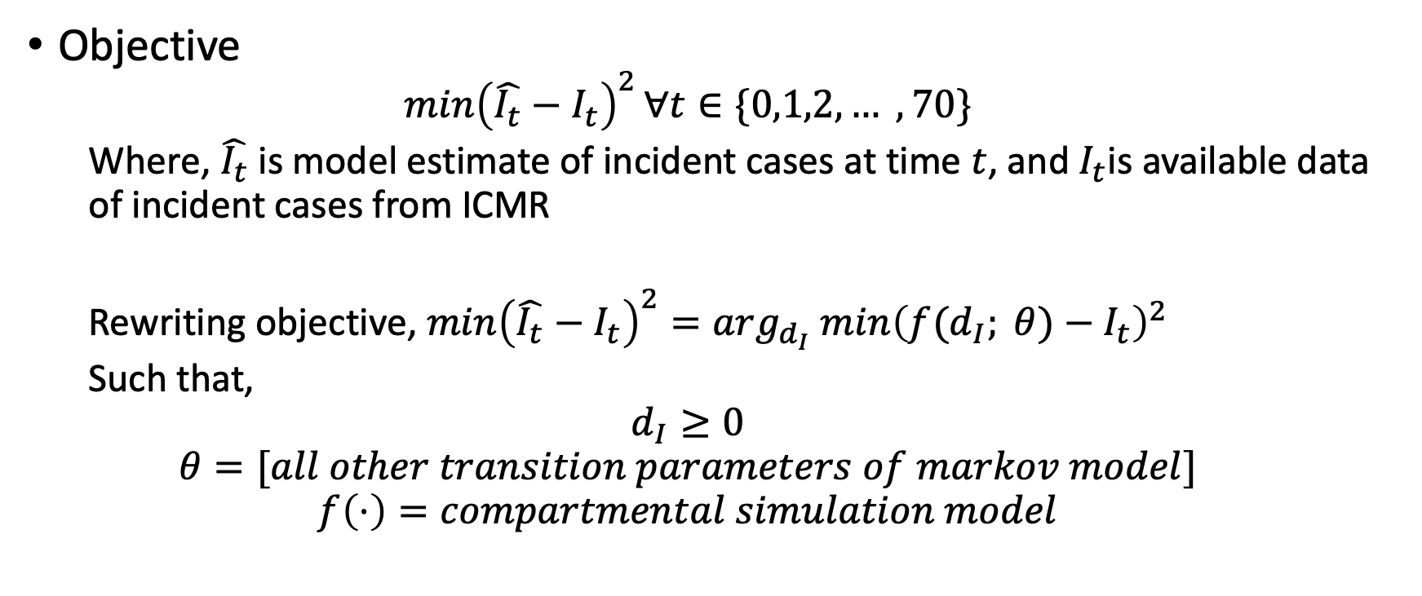
Non-linear optimization formulation
Objective
$${\min\left(\hat{I_{t}}−I_{t}\right)}^{2}∀t∈\{0,1,2, … ,70\}$$
Where, $\hat{I_{t}}$ is model estimate of incident cases at time $t$, and $I_{t}$is available data of incident cases from ICMR
Rewriting objective, ${\min\left(\hat{I_{t}}−I_{t}\right)}^{2}={arg_{d_{I}} min\left(f(d_{I}; θ)−I_{t}\right)}^{2}$
Such that,
$$d_{I}≥0$$
$$θ=[all other transition parameters of markov model]$$
$$f\left(⋅\right)=compartmental simulation model$$

Slide 6
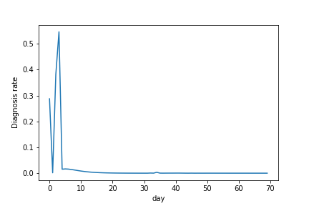
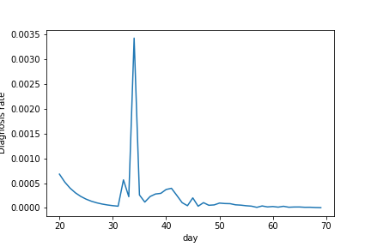
Result for testing/diagnosis rate

Slide 7
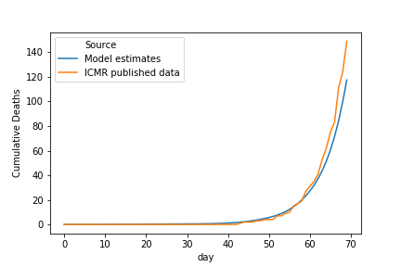
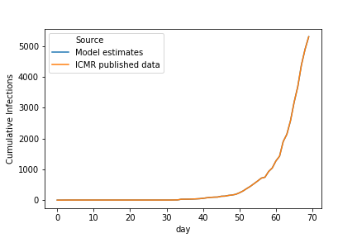
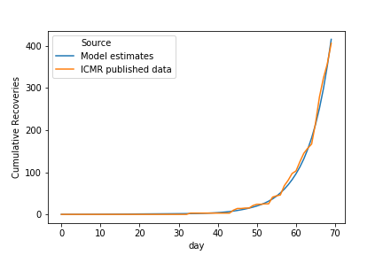

Model fit $(R_{0}=2.2)$

Slide 8
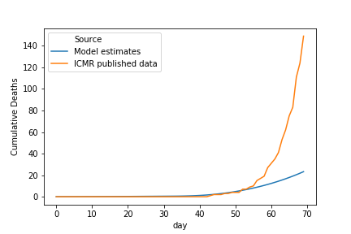
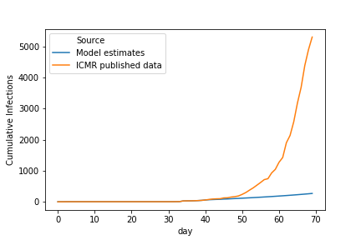
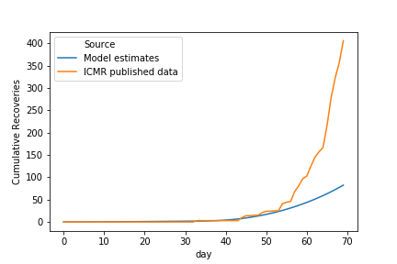

Model fit $(R_{0}=1.2)$

Slide 9

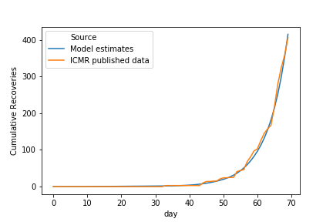

Model fit $(R_{0}=3.2)$

Slide 11

Progression rate $(γ)$
Incubation period
Time from onset to first symptom
Ref : Lauer, S. A., Grantz, K. H., Bi, Q., Jones, F. K., Zheng, Q., Meredith, H. R., ... & Lessler, J. (2020). The incubation period of coronavirus disease 2019 (COVID-19) from publicly reported confirmed cases: estimation and application. Annals of internal medicine.
Median incubation period = 5.1 days
97.5% of those who develop symptoms will do so in 11.5 days
101 cases/10,000 will develop symptoms after 14 days

Slide 12
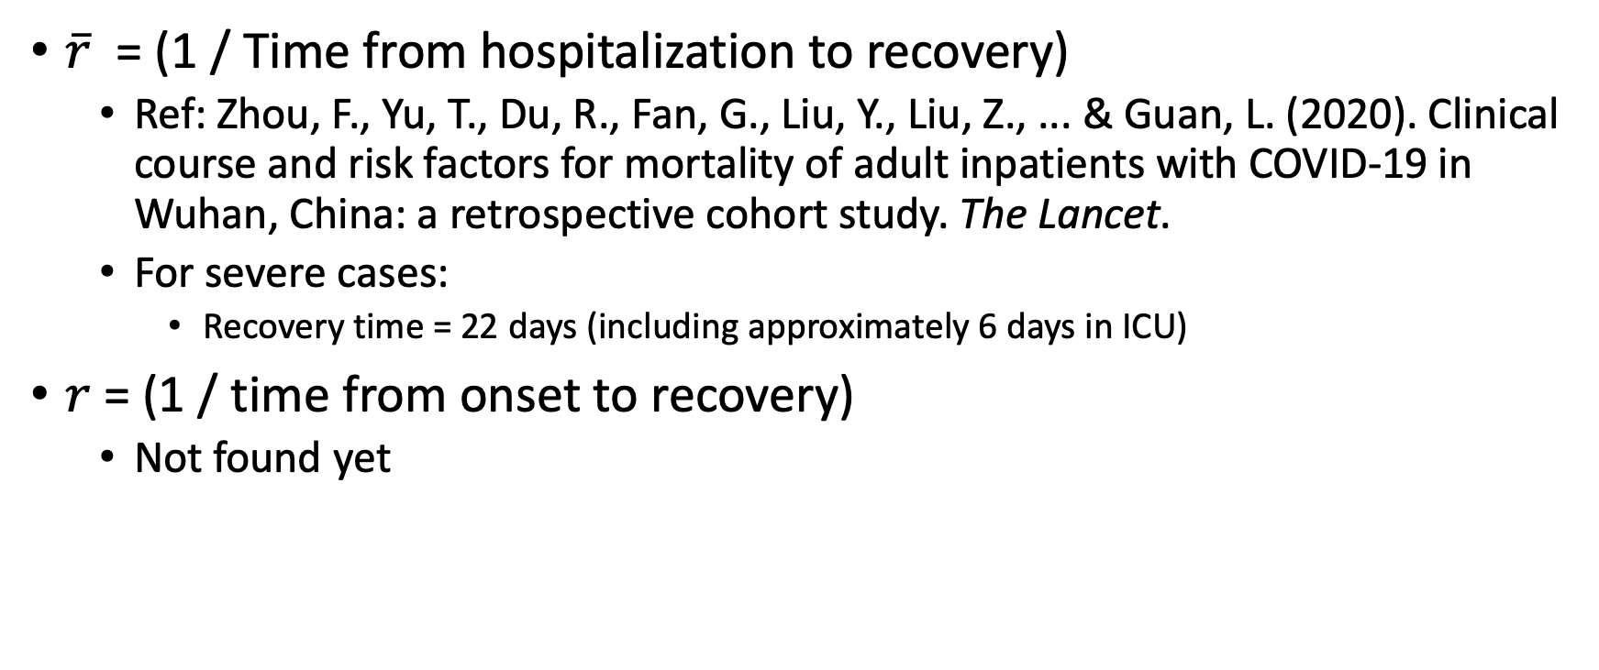

Recovery rate $(r, \overline{r})$
$\overline{r}$ = (1 / Time from hospitalization to recovery)
Ref: Zhou, F., Yu, T., Du, R., Fan, G., Liu, Y., Liu, Z., ... & Guan, L. (2020). Clinical course and risk factors for mortality of adult inpatients with COVID-19 in Wuhan, China: a retrospective cohort study. The Lancet.
For severe cases:
Recovery time = 22 days (including approximately 6 days in ICU)
$r$ = (1 / time from onset to recovery)
Not found yet

Slide 13
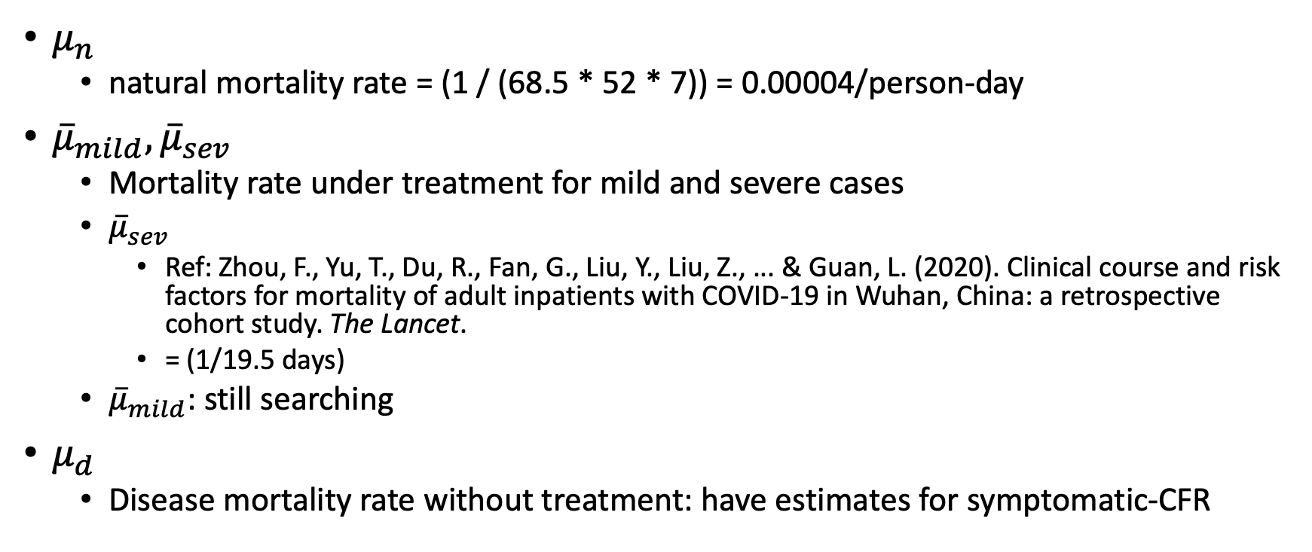

Mortality rate $(μ_{n},μ_{d}, {\overline{μ}}_{mild},{\overline{μ}}_{sev})$
$μ_{n}$
natural mortality rate = (1 / (68.5 * 52 * 7)) = 0.00004/person-day
${\overline{μ}}_{mild},{\overline{μ}}_{sev}$
Mortality rate under treatment for mild and severe cases
${\overline{μ}}_{sev}$
Ref: Zhou, F., Yu, T., Du, R., Fan, G., Liu, Y., Liu, Z., ... & Guan, L. (2020). Clinical course and risk factors for mortality of adult inpatients with COVID-19 in Wuhan, China: a retrospective cohort study. The Lancet.
= (1/19.5 days)
${\overline{μ}}_{mild}$: still searching
$μ_{d}$
Disease mortality rate without treatment: have estimates for symptomatic-CFR

Slide 14
Case fatality rate for symptomatic cases
CFR is (deaths/patients), for our model we want (deaths/person-day)
CFR estimates
Ref: Wu, J. T., Leung, K., Bushman, M., Kishore, N., Niehus, R., de Salazar, P. M., ... & Leung, G. M. (2020). Estimating clinical severity of COVID-19 from the transmission dynamics in Wuhan, China. Nature Medicine, 1-5.
Age | Symptomatic-CFR
<30 | 0.3%
30-59 | 0.5%
>59 | 2.6%

Slide 15
Birth rate for exposed state
Growth in the population of exposed compartment will be due to the transmission generating from exposed and undiagnosed symptomatic cases.
Reproduction rate of COVID19
Ref: Wang, C., Liu, L., Hao, X., Guo, H., Wang, Q., Huang, J., ... & Wei, S. (2020). Evolving Epidemiology and Impact of Non-pharmaceutical Interventions on the Outbreak of Coronavirus Disease 2019 in Wuhan, China. medRxiv.
Social distancing status | Reproductive number
No social distancing | 3.88
Mandatory social distancing | 1.26
Quarantining | 0.32

